Slide 1


Community Action Partnership Utah Virtual Conference
June 24, 2020
Amber Rich and Angela Choberka,
Community Partnership Specialists
Notes:
Angela and Amber introduce themselves

Slide 2





Correlation Between Social Determinants of Health and Improved Health Outcomes
Notes:
Amber

Slide 3
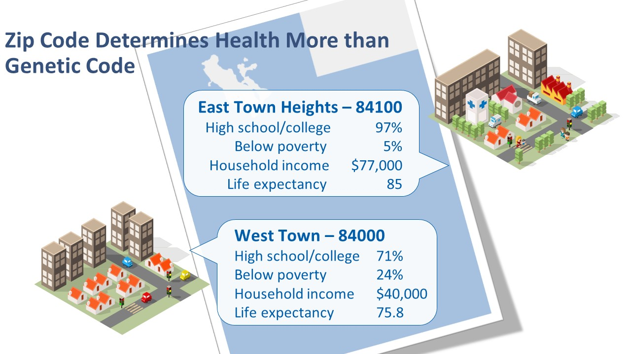
Notes:
Amber
These are actual communities in SLC but names and zip codes are fictional. These neighboring areas reflect the difference a block or two can make in health and life expectancy. In this case those with higher income and education can expect to live 10 years longer than their neighbors.

Slide 4
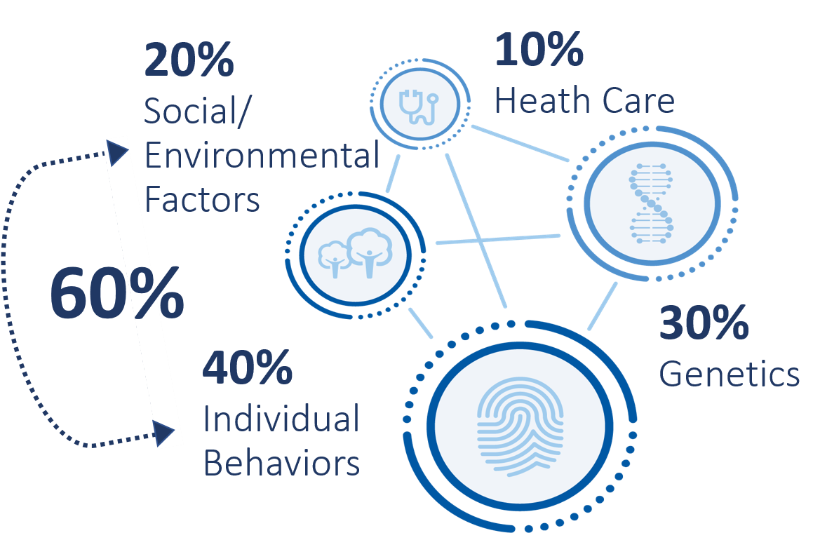
Helping people live the healthiest lives possible®
Health Care
40%
Individual
Behaviors
Notes:
Amber
The SDoH – including health behaviors, environments, income, housing – are proven to the greatest impact on health and life expectancy. In the U.S. 90% of our healthcare spending is in medical services, and it only impacts approximately 10% of our overall health. Social/ Environmental factors and individual behaviors impact upwards of 60% of our overall health.

Slide 5
Mismatch Between Drivers of Health and Spending
Health & well-being
U.S. healthcare spend: $3.6 trillion
Healthcare
Genetics
Social & Environmental Factors
Medical Services
Individual Behaviors
Healthy Behaviors
Notes:
Amber
How do we do this in today’s environment of resource gaps?
Even though healthcare contributes only 10% to our health, it consumes 90% of the $3.6 trillion we spend while 10% goes towards influencing behaviors and arguably we are squeezing dollars available for education, etc.

Slide 6

One of our Biggest Ethical Dilemmas in Healthcare
HEALTH EQUITY
People in low income neighborhoods are 10X more likely to undergo limb amputation
from diabetes
Children in poor, rural communities had nearly 3X higher mortality rate compared to those in affluent, rural areas
Notes:
Amber
Helping people live the healthiest lives possible is not possible when the scales are tipped in favor of those who reside in certain zip codes or fall into a certain demographic.

Slide 7
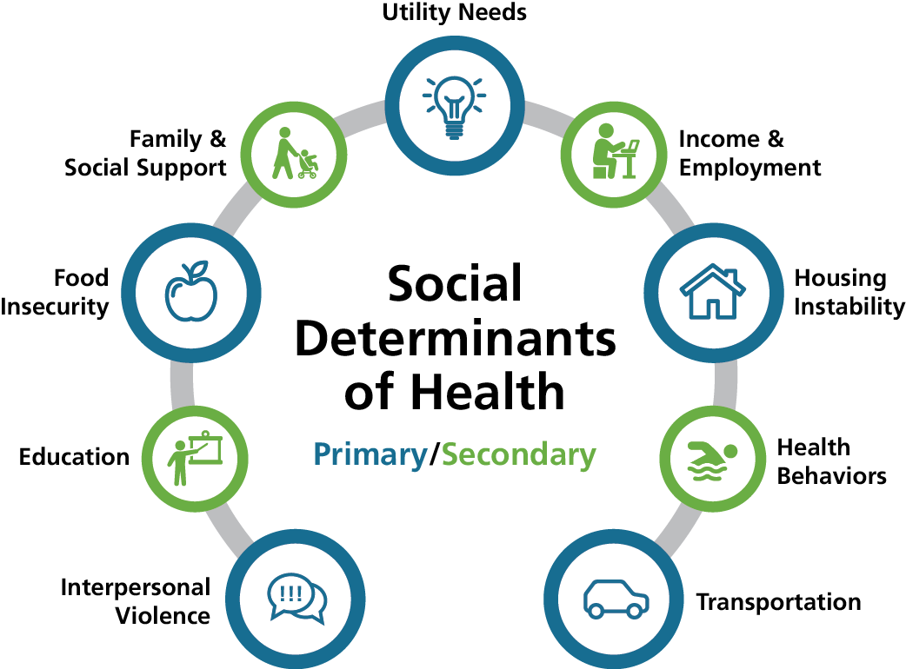
Influencing the Social Determinants
Notes:
Angela
Social Determinants of Health are those factors outside healthcare that have consistently proven to have greater impact on our health and well-being. The primary drivers of health that the Alliance focuses on are:
Interpersonal Violence
Food Insecurity
Utilities
Housing
Transportation
This is easily relatable to Maslow’s Hierarchy of Needs. We need to address basic needs before we can impact health behaviors and medical interventions with lasting effect. Intermountain is investing $12 million to address social need through the Alliance
The Alliance work is based on the Healthy People 2020 model, the federally adopted standard.

Slide 8



Alliance Scope: SelectHealth Community Care Members (Medicaid) in two Utah counties
WASHINGTON COUNTY
WEBER COUNTY
Notes:
Angela
Factors that influenced the selection of the geographies:
Lower than average life expectancy
High behavioral health needs
High emergency room use for non-emergency needs
Community readiness

Slide 9



Alliance Objective: Improve health outcomes, reduce healthcare costs, and be a model for change by addressing social determinants of health
Align social services and care delivery
Remove silos among delivery systems, public health and community based-organizations
Use technology and data sharing to find solutions
Notes:
Angela
What the Alliance aims to do is address these social and healthcare needs to lower the total cost of healthcare, create more health equity, and allow more people to the live the healthiest lives possible regardless of where they work, live, play or pray.

Slide 10



























Alliance Steering Committees
Supporters:
Dr. Ezekiel R. & Edna Wattis Dumke Foundation
Notes:
Angela

Slide 11

The Value Community Health Workers Can Add to the Care Team
Notes:
Amber

Slide 12
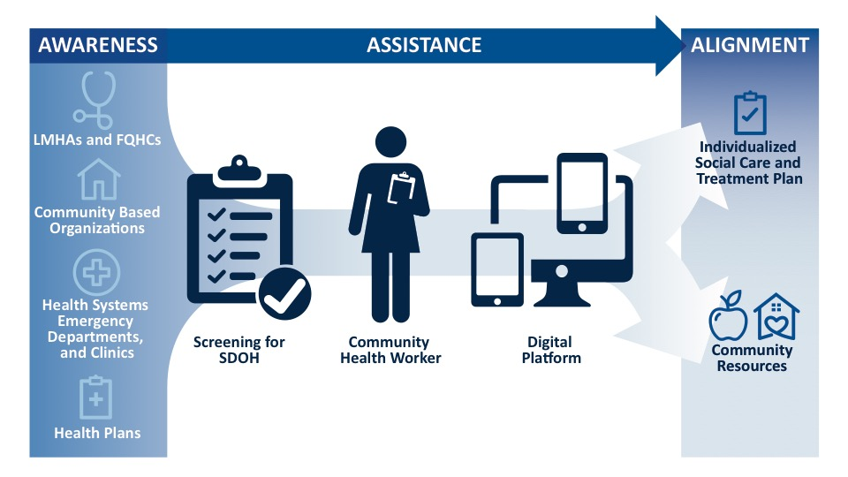
Notes:
Amber
The Alliance model is based on the three-pronged CMS Accountable Health Communities Model of awareness, assistance, and alignment.

Slide 13
A Personal Health Story
Unemployed and on disability due to mental health conditions
Foster care as child; support from church and pastor
Runs out of money the 10th of the month
Using government support (ex. Food stamps)
Living in a motel for the last 5 years
Did not graduate high school
Used illicit substances
Physical removal of mother in episode where firearm was present
Notes:
Amber
These are the actually needs of a Medicaid member in our community.
CHWs provide direct, empathetic observations where people live and work. They have lived experience and use motivational interviewing to assist the participants in prioritize their social needs.
Common Themes:
Prevalent behavioral health conditions
Unidentified substance use disorders
Multiple generations experiencing unmet social needs
Housing instability – frequent moves, evictions, temporary housing
Multiple unmet social needs
Unemployment as a determinant of health
Uncoordinated social service support

Slide 14
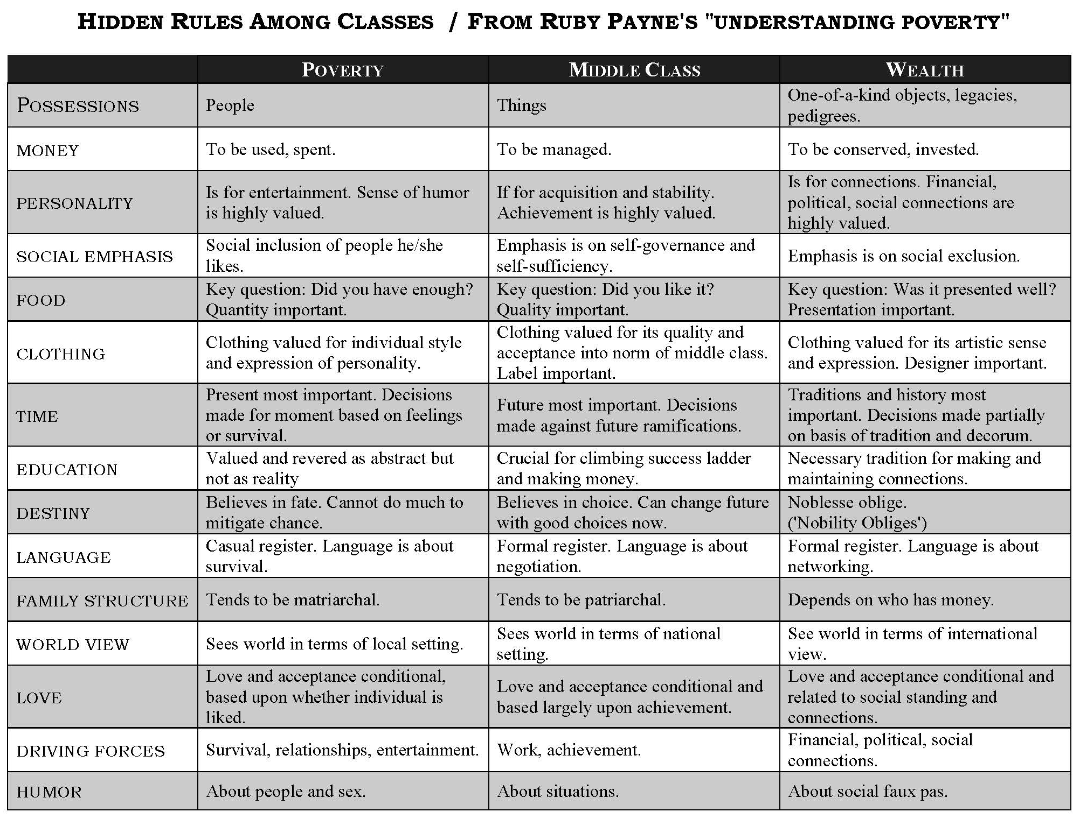
Notes:
Amber

Slide 15
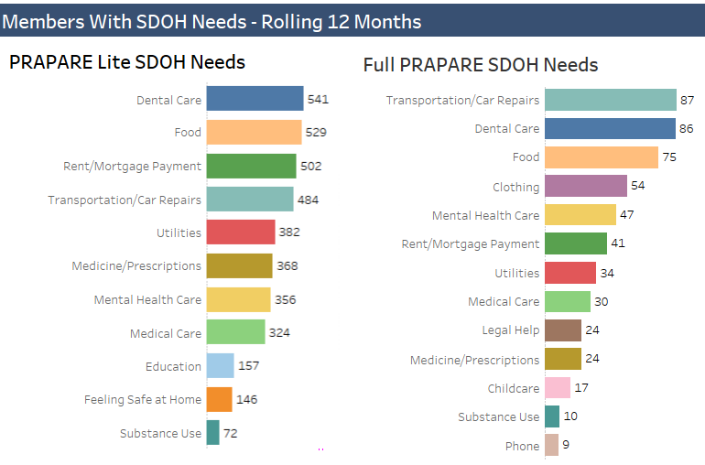
Notes:
Amber
Needs identified through the PRAPARE Lite and full PRAPARE which are assessments to identifies SDOH needs.

Slide 16
Connect Us Coordinated Network
Notes:
Angela

Slide 17
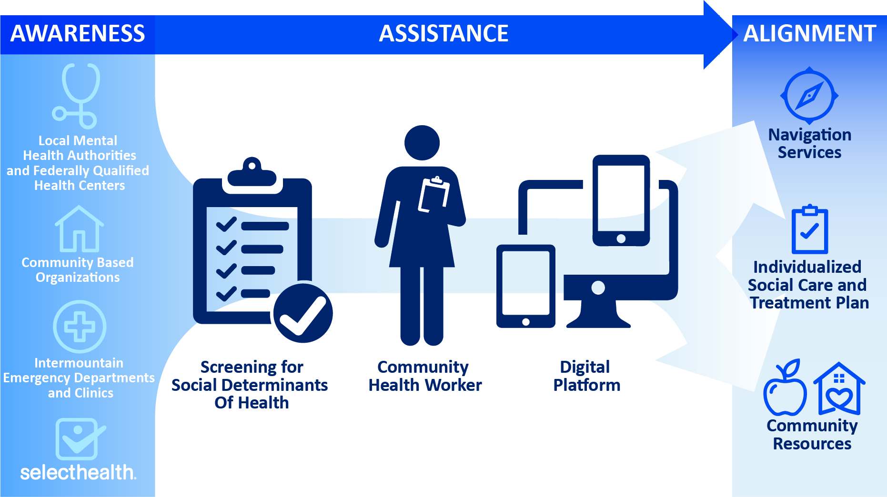
Notes:
Angela
The digital platform is managed by United Way of Salt Lake/Utah 211. Please connect with them to learn more about how to join.
Currently in Washington, Weber, and Utah Counties.

Slide 18


Connect Us Network
Launched August 1, 2019 in Weber and Washington Counties
53
468
239
732
Organizational Sites
Unite Us Users
Unique Clients
Referrals
Notes:
Angela
As of 6/16/20

Slide 19




















About Unite Us
Veteran-founded technology provider
Over 48 networks in 21 states & Washington D.C.
Notes:
Angela

Slide 20









What is a Coordinated Network?
A coordinated network connects providers (such as health care providers, insurers, or community organizations) through a shared technology platform to:
Communicate in real-time
Make electronic referrals
Securely share client information
Track outcomes together
Notes:
Angela

Slide 21






Coordination Platform
Improving efficiency and accuracy
Traditional Referral
Powered by Unite Us
Client
Healthcare Provider
Housing Provider
Housing Provider
Client
Healthcare Provider
Service provider cannot always exchange PII or PHI through a secure method.
Limited prescreening for eligibility, capacity, or geography.
Onus is usually on the client to reach the organization to which they were referred.
Service providers have limited feedback loop.
Client data and interaction tracking are siloed.
All information is stored and transferred on HIPAA compliant platform.
Client is more easily matched with providers or programs for which they qualify.
Client’s information is captured once and shared on their behalf across providers.
Service providers have insight into a client’s entire journey.
Longitudinal data is tracked to allow for informed decision making by community care teams.
Notes:
Angela

Slide 22
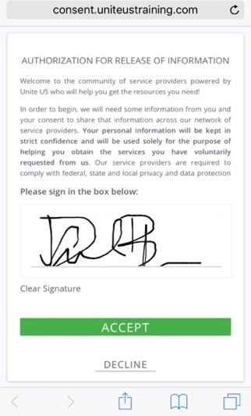

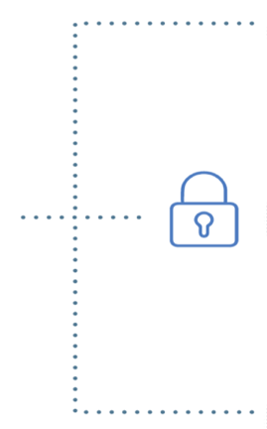





Privacy & Security
Compliant with Health Insurance Portability and Accountability Act (HIPAA) & Personally Identifiable Information (PII) standards.
INFORMED CONSENT FOR PARTICIPATION & INFORMATION SHARING
EMPLOYMENT
Compliant with Security & Data Storage Standards and Breach & Enforcement Rules.
DOCTOR
CLIENT
HOUSING PROVIDER
Protected information (e.g. outcomes for Mental Health or Substance Use cases) is restricted from view based on users’ viewing permissions.
Informed consent is requested by the system ONCE, before the first referral is made. Clients consent to have their information shared in order to receive services from network partners.
MENTAL HEALTH
Notes:
Angela

Slide 23





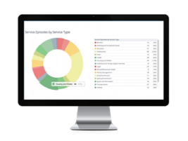
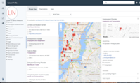
Network Model: Any-Door Approach
Understanding Referral Workflows
Housing Need Identified
Additional Needs Identified
Referral
Referral
Client
Care Coordinator
Housing
Provider
Employment
Provider
Notes:
Angela

Slide 24
How It Works:
Coordinated Network
Housing Need Identified
Referral
Referral
Client
Employment Provider
Coordination Center
Housing Provider
Notes:
Angela

Slide 25






Prospective Network Design: Hybrid Model
Coordination Center(s)
Community
Health Worker
Emergency Dept.
Discharge Coordinator
Homeless
Shelter
Benefits Enrollment
Specialist
FQHC
School Programs
Homeless Shelter
Food Bank
Notes:
Angela

Slide 26
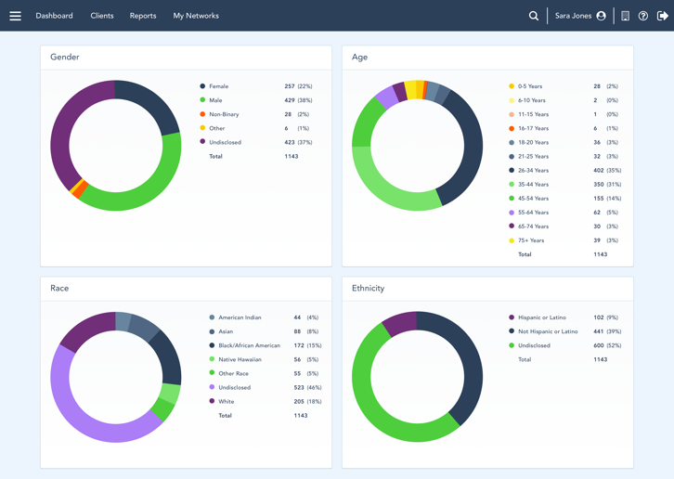
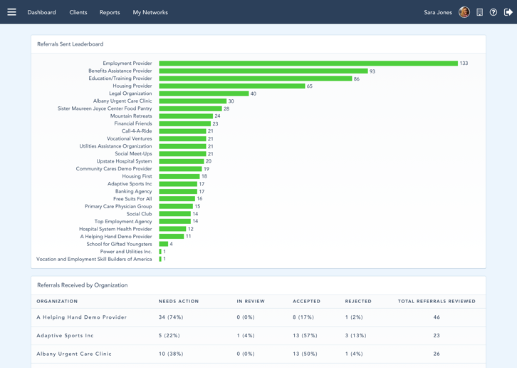
The Data You Need
Real-time reporting of outcomes, impact, performance, and efficiency
Client Level Coordination and Tracking
Network Level Transparency & Accountability
Client Demographics
Client Access Points
Service Delivery History
Outcome Breakdowns
Service Episode History (Longitudinal)
Referrals Created
Received By
Structured Client Outcomes
Notes:
Angela

Slide 27
THANK YOU

