Slide 1
Pursuing A Whole Family Approach
Tiffney Marley, CCAP, NCRT
Vice President, Practice Transformation
National Community Action Partnership
Jeannie Chaffin, CCAP
WFA Special Advisor
National Community Action Partnership

Slide 2
Tiffney Marley
Vice President, Practice Transformation
National Community Action Partnership

Slide 3
Jeannie Chaffin
Whole Family Approach Special Advisor
National Community Action Partnership

Slide 4
Objective
Engage in Learning: Develop a deeper understanding of the 2Gen/Whole Family Approach (WFA)
Notes:
Engage in Shared Learning: Develop a deeper understanding of the 2Gen/WFA Approach.

Slide 5
What do we know about the development of parents and children?
Notes:
Type response in the chat box.

Slide 6
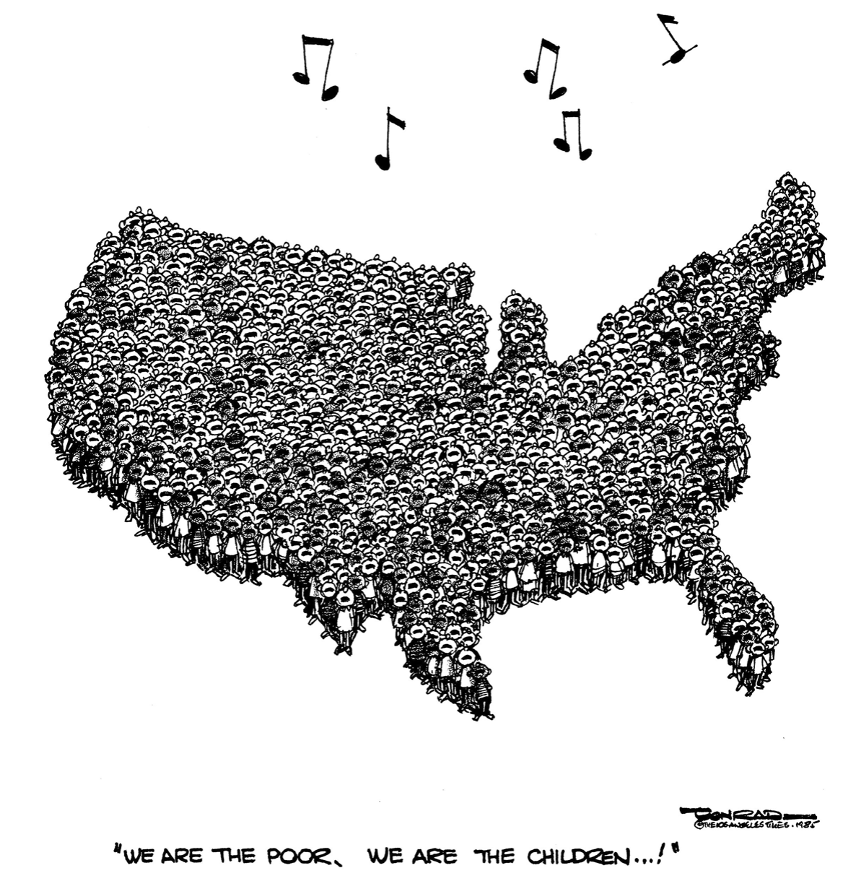
Our Children Are Our Future
About 14% or 10 million children live in poverty (SPM)
Our youngest children are our poorest
8.5 million or 12% of all kids live in areas of concentrated poverty.
2 in 3 poor children in related families live with an adult who works
Children’s Defense Fund, Ending Child Poverty Now
Notes:
14% (13.7%) is the 2018 Supplemental Poverty measure
14% (14.2) is the 2017 Supplemental Poverty measure (this measure was updated by Census in 2019 previous number was 15.6% or approx. 16%
165 (16.5% is the 2018 Official Poverty Measure
18% (17.5) is the 2017 Official Poverty Measure
2014-2018 ACS 5 year average for children under 18 in poverty is 19.5% or 14.1 million
2013-2017 ACS 5 year average for children under 18 in poverty is 20.3% or 14.7 million
2012-2016 ACS 5 year average for children under 18 in poverty is 19% or 15.3 million
Areas of concentrated poverty= census tracts with overall poverty rates of 30% ore more. Research has indicated that children under age 13 who moved from low-income neighborhoods to more affluent communities had higher incomes as adults compared to their peers who remained in impoverished areas.
Nearly 1 in 3 live with a family members who works full-time, year round,.

Slide 7
Race and Poverty
“While projected to be the majority by 2043, children of color are disproportionately impacted by poverty, resulting in the lack of access to the opportunities, resources, and support they need to thrive…”
Notes:
This is due in large part to a wide array of racialized national, state, and local policies and practices that undermine their well-being and success
African- American and American Indian children are 7 times more likely to live in high-poverty neighborhoods than white kids. Latino children are nearly five times more likely.
These disparities are the legacies of racial and ethnic oppression, as well as the result of present-day laws and practices.
file:///Users/eugenialchaffin/Downloads/aecf-childrenlivinginhighpoverty-2019%20(2).pdf

Slide 8
High Poverty, Low-Opportunity

Slide 9
Economic and Socially Dangerous
Every year we leave millions of children in poverty, our nation experiences $700 billion in lost productivity and increased health and crime costs
3 of the richest men in America hold more of our nation’s wealth than the bottom half of our population of 327 million people.
Notes:
Economic Waste
Blight on our national soul
Bezos, Gates, Buffett, 415.4 billion + to bottom half 164 million people

Slide 10
Growing Up In Poverty
“Growing up in poverty undermines healthy child development and can perpetuate negative impacts for a lifespan.”

Slide 11
Our Future
The future social and economic security for all of us is at stake…
Notes:
As we work to uproot the causes and conditions of poverty, we must do so comprehensively and we must do this work together. We are all in this together...

Slide 12
Vision
Results beyond anything achieved before
“Meeting Families where they dream…”
Maximizing people's potential to contribute to the civic, social, and economic lives of our communities.
Producing a legacy of family well-being that passes from one generation to the next.
Notes:
More important than meeting families where they are is meeting families where they dream

Slide 13
Accelerating Social and Economic Mobility
Achieving this vision will require accelerating social and economic mobility beyond anything we have done before.
The vision many of us aspire to requires deeper engagement with families, being data driven, person-centered, attention to racial equity, innovation, and achieving greater impact.
Notes:
Economic mainstream
Life trajectories
Accelerating social and economic mobility
strengthening pathways to opportunity for low-income people in America’s cities, seeking to dismantle structural and systemic barriers to equality and justice
Fostering the next generation of human services organizations
Are person-centered.
Are outcomes-based.
Are data-driven.
Apply a racial equity lens.
Focus on greater sector impact and systems change.
Place based opportunity ecosystems

Slide 14
Starting with Human Capacity

Slide 15
Human Capacity
The idea that people grow and change over
their lives, in an ongoing process shaped by environments and experiences (Human Development).
Framing Two-Generation Approaches to Supporting Families, Ascend at the Aspen Institute, 2019. For more information go to: https://ascend.aspeninstitute.org/resources/framing-two-generation-approaches-to-supporting-families/

Slide 16
Environments and Experiences
Notes:
People are shaped by their environment and shape their environment

Slide 17
Environments and Experiences
Building Community Resilience Collaborative at the Redstone Center, George Washington University

Slide 18
Human Capacity
We have a role and a stake in ensuring that the vital conditions for optimal development are available to all, not just some, across the various stages of development.
Framing Two-Generation Approaches to Supporting Families, Ascend at the Aspen Institute, 2019. For more information go to: https://ascend.aspeninstitute.org/resources/framing-two-generation-approaches-to-supporting-families/

Slide 19
Human Capacity
Everyone has value and given the right conditions, they have the ability to live up to their fullest potential.
Framing Two-Generation Approaches to Supporting Families, Ascend at the Aspen Institute, 2019. For more information go to: https://ascend.aspeninstitute.org/resources/framing-two-generation-approaches-to-supporting-families/

Slide 20
Human Capacity
“When we support well-being, we make sure that everyone can reach their fullest potential and contribute to our communities. Maximizing people’s potential helps our communities thrive.”
Framing Two-Generation Approaches to Supporting Families, Ascend at the Aspen Institute, 2019. For more information go to: https://ascend.aspeninstitute.org/resources/framing-two-generation-approaches-to-supporting-families/
Notes:
As we work to uproot the causes and conditions of poverty, we must do so comprehensively and we must do this work together. We are all in this together...

Slide 21
Improving Outcomes for Children and Families
Center for the Developing Child, Harvard University
Notes:
3 Principles to Improve Outcomes for Children and Families.
Can we address all three areas with our approach?

Slide 22
The Whole Family Approach Lens
… building the well-being of children and the adults in their lives together, resulting in stronger and better lives for both generations
Framing Two-Generation Approaches to Supporting Families, Ascend at the Aspen Institute, 2019. For more information go to: https://ascend.aspeninstitute.org/resources/framing-two-generation-approaches-to-supporting-families/
Notes:
Legacy of well-being, break the cycle of poverty.

Slide 23
The Whole Family Approach Lens
Families have the potential to grow and change
Framing Two-Generation Approaches to Supporting Families, Ascend at the Aspen Institute, 2019. For more information go to: https://ascend.aspeninstitute.org/resources/framing-two-generation-approaches-to-supporting-families/

Slide 24
Understanding the 2Gen/WFA

Slide 25
Service Integration Defined
The concept of coordinating access to multiple types of services in order to empower economic stability and resiliency for customers.
aka Bundled Services
Notes:
Community Action Agencies have long recognized the need to offer comprehensive services often in one location to foster access to services and to mobilize customers. Service Integration is a promising practice which strengthens this approach.
This approach is about much more than referring a customer to multiple programs so they can obtain additional services. Integrated services suggests a change in the organization's mindset and composition that leads to an integrative approach to service delivery on every level of the agency.

Slide 26
Service Integration and 2Gen
Service Integration
2Gen
Prisoner Reentry
Notes:
How do you integrate services? What services are integrated, how are those services funded? What populations are you integrating services for? Is all your integration inside the CAA or is some of it with partners?
Veterans, homeless,

Slide 27
Whole Family/2 Gen Approach Defined
Building family well-being by working with children and the adults in their lives together
Results: Efficiency is improved and outcomes are enhanced for parents, children, families, and communities
Notes:
What is 2Gen?
Two-generation (2Gen) approaches build family well-being by intentionally and simultaneously working with children and the adults in their lives together. As children, parents and families grow and change across their lifespan, 2Gen approaches align opportunities to help families pursue their goals and thrive, optimizing each person’s potential along the way. The results are healthy parents with family-supporting jobs, healthy children meeting developmental milestones, and better-connected individuals able to participate in civic and family life. By producing a legacy of family well-being that passes from one generation to the next, 2Gen helps communities become stronger and more vibrant, socially and economically.

Slide 28
Ascend 2Gen Continuum

Slide 29
Aspen Ascend Theory of Change

Slide 30
Aspen Ascend Theory of Change
Notes:
INTENTIONALITY, QUALITY, INTENSITY of services
Young children cannot be their sole change agents – they live within a family
New brain science is revealing that the birth of the child changes a parent’s brain architecture – creating a window of opportunity
Anecdotal evidence suggests parents are motivated to do better themselves when they see their child progressing in education

Slide 31
2Gen/WF Approach Characteristics
Family goals shared across programs
Goals include outcomes for children, parents, and family
Alignment of a suite of services for families that respond to their unique needs across a number of domains
Easier access to services
High quality, intensive, intentional parent and child services at the same time

Slide 32
What Have We Learned From 2Gen 1.0?
Intentional service integration is critical.
Quality matters.
Intensity is important.
Who is targeted matters.
How you work with families matters.

Slide 33
Ascend 2Gen Guiding Principles
Measure and account for outcomes for both children and their parents.
Engage and listen to the voices of families
Ensure equity.
Foster Innovation and evidence together.
Align and link systems and funding streams
Source: Ascend, Guiding Principles

Slide 34
Tools and Resources
How Organizations are Making the Shift to a Whole Family Approach

Slide 35
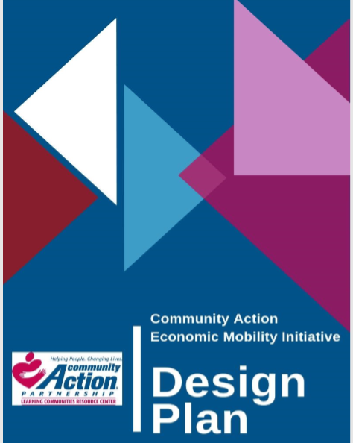
Design Plan
Support for completing components necessary to design a whole family approach
Establish clear vision and results
Identify internal and external partners
Plan and implement activities to engage customer voice
Develop information for theory of change and logic model

Slide 37
Design Plan Checklist Continued

Slide 38
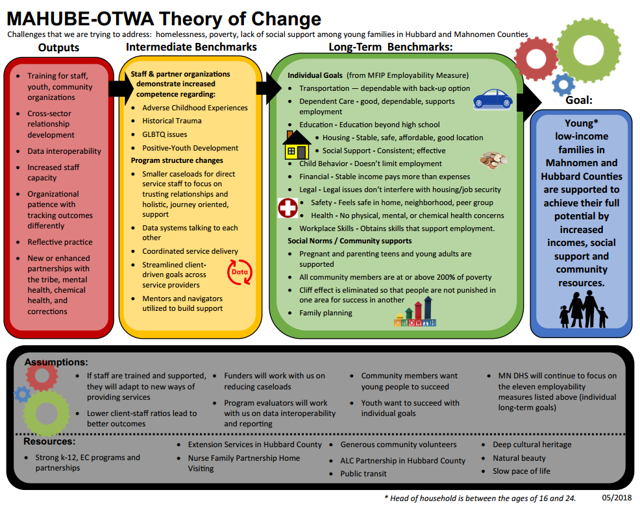

Slide 39
Internal & External Aspects
Whole Family Approach Building Blocks
Securing Funding and Other Resources
Building and Using Leadership
Engaging Family Voices
Attending to Organizational Culture and Systems
Aligning High Quality, Intentional, Intensive Services to Parents & Children
Parent and Child Service Integration
Understanding System, and Policy Change That Supports Parents and Children
Designing and Implementing with an Equity Lens
Notes:
Listened to CAA leaders who are implementing the whole family approach as well as deeply thought the key aspects of the framework and arrived at the following building blocks.

Slide 40
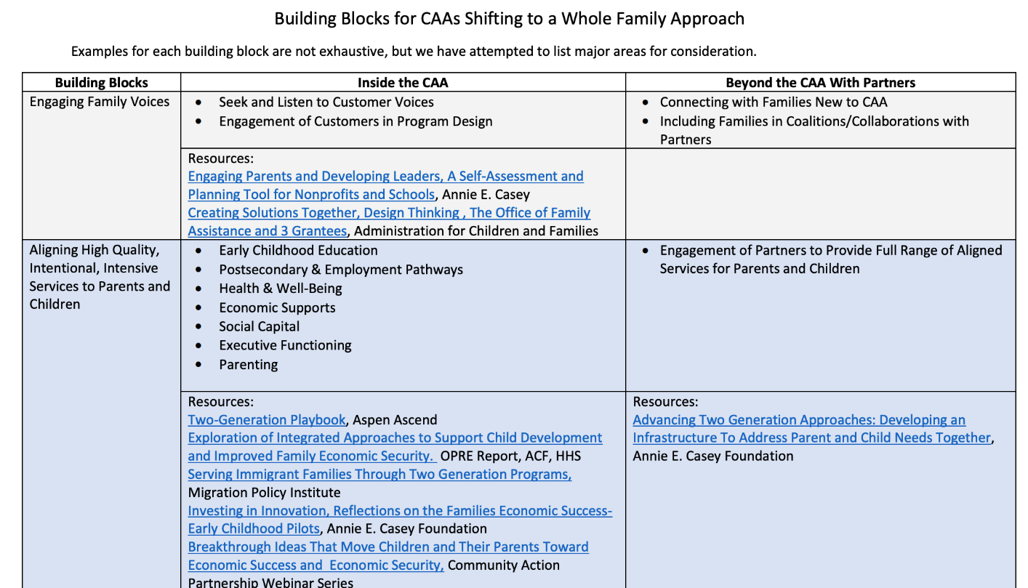
Building Block Resources
Building Blocks for CAAs Shifting to a Whole Family Approach

Slide 41
Systems Change Tactics (Practice, Administration, Policy)
Light Lift | Middle Lift | Heavy Lift
Single Family Service Plan (Across Programs) |  | Single Family Service Plan (Across Organizations)
 | Common Family Assessment
Co-locate Services (Satellite Model) | Virtual One-Stop Shop and Common Application | One-Stop Shop (Physically locate distinct programs in same place)
 |  | Realign supervision structures (Common managers and/or jointly managing related programs)
Consolidated Intake | Consolidated Intake | Consolidated Intake
Split eligibility and case management functions out of job positions. | Consolidate job functions- expand expertise of front-line workers
Blend/braid funding streams | Blend/braid funding streams | Blend/braid funding streams
Coordinated case planning between 2 key programs | Coordinated case planning across multiple programs | Coordinated case planning across multiple organizations.

Slide 42
Systems Change Tactics (Practice, Administration, Policy)
Light Lift | Middle Lift | Heavy Lift
Set Common/Shared Outcome Measures (small scope) | Common/Shared Outcome Measures (medium scope) | Common/Shared Outcome Measures (Community-Wide Scope)
 | Integrated IT Systems (small scope) | Integrated IT Systems (Broad Scope)
Co-designing along-side Families | Co-designing along-side Families
 | Centering racial equity in all aspects of design and delivery | Centering racial equity in all aspects of design and delivery
 | Revise staffing distribution levels and supervision
Including families on agency guiding coalition
Conducting racial equity assessment | Baking in racial equity review to all policy discussions.
Adding CQI review of child, parent, and family data quarterly
Notes:
Scale, pilot, support of funders, leaders

Slide 43
2Gen Approach Resources
Aspen Ascend
Making Tomorrow Better Together
2Gen Outcomes Bank
2Gen Toolbox
101 Trying on a 2Gen Approach
201 2Gen Action Plan
301 Community Guide to 2Gen Approaches

Slide 44
2Gen Approach Resources
Administration for Children and Families,
Office of Planning, Research & Evaluation
Conceptual Frameworks for Intentional Approaches to Improving Economic Security and Child Well-being
Features of Programs Designed to Help Families Achieve Economic Security and Promote Child Well-being
Using Research and Evaluation to Support Programs that Promote Parents’ Economic Security and Children’s Well-being

Slide 45
Contact Info
Tiffney Marley, CCAP, NCRT
Vice President, Practice Transformation
tmarley@communityactionpartnership.com
Jeannie Chaffin, CCAP
National Partnership WFA Special Advisor
Chaffin.Jeannie@gmail.com

