Slide 1

Risk Management in a Very Risky World
June 24, 2020
Region VIII Community Action Partnership
Virtual CAP Conference
Workshop Leader: Kay Sohl

Slide 2

What is Risk?
The possibility that a present process or future event will have negative consequences

Slide 3
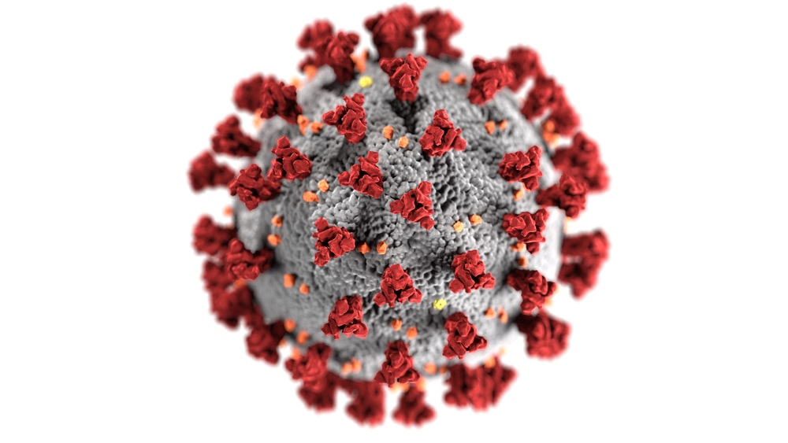
CAA World of Risks
Fraud
Compliance
Personnel
Sustainability
Program
Governance
Technology
Environmental
Facilities
???

Slide 4
Risk Management
The process used to identify and measure risk and the development of strategies to manage it

Slide 5
Core Risk Management Strategies
Risk Assessment
Evaluation
Management
Mitigation
Tolerance
Avoidance

Slide 6
Why Do Risk Assessment
Common sense
Protect our agency
Required by funding sources

Slide 7
CSBG Organizational Standards
Standard 4.6
Private
An organization-wide, comprehensive risk assessment has been completed within the past 2 years and reported to the governing board.
Public
The department complies with its local government’s risk assessment policies and procedures.

Slide 8
Community Action Partnership
Risk Assessment Toolkit
https://portal.nonprofitrisk.org/CAP/
Easy-to-use FAQs
Checklists:
  Internal Control Review
  Boards & Committees
  Low Income Representatives
  Program Manager

Slide 9
Community Action Network
COVID -19 Weekly Update
Every other Thursday
3 PM Eastern
Register through Partnership
https://communityactionpartnership.com/news/community-action-network-covid-19-weekly-update/

Slide 10
CAPLAW Corona Virus
Risk Management Resources
https://www.caplaw.org/resources/PublicationDocuments/CAPLAW_ManagingCoronavirusRisks_CommunityAction_March2020.pdf 3-5-20
https://www.caplaw.org/resources/coronavirusupdates/reopening/intro.htm
5-21-20 Webinar

Slide 11
Practical Framework for
CAA Risk Management
COSO Integrated Framework
for Internal Controls
Updated version May 2013
Free downloadable Executive Summary
https://www.coso.org/Documents/990025P-Executive-Summary-final-may20.pdf

Slide 12
COSO Guidance:
Enterprise Risk Management
Updated 2017
https://www.coso.org/Documents/2017-COSO-ERM-Integrating-with-Strategy-and-Performance-Executive-Summary.pdf
Broader view of risk management
  Governance & Culture
  Strategy & Objective Setting
  Performance
  Review & Revision
  Information, Communication & Reporting

Slide 13
COSO
http://www.coso.org/documents/coso%202013%20icfr%20executive_summary.pdf
Committee of Sponsoring Organizations:
  American Accounting Association
  American Institute of CPAs
  Financial Executives International
  IMA- Assoc. of Accountants & Financial Professionals in Business
  Institute of Internal Auditors

Slide 14
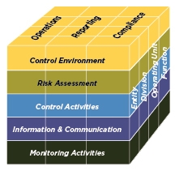
COSO
Internal Control Framework

Slide 15
COSO Framework
Control environment
Risk assessment
Control activities
Information sharing & communication
Monitoring

Slide 16
Nonprofits Can Use COSO to
Identify & address multiple risks
Develop cost effective approach to controls
Document system of controls
Avoid human, financial,& reputational damage

Slide 17
COSO defines Internal Control
  A process effected by an entity’s board of directors, management & other personnel, designed to provide reasonable assurance regarding achievement of objectives in…
    Effectiveness & efficiency in operations
    Reliability of financial reporting
    Compliance with applicable laws & regulations

Slide 18
Internal Controls designed to:
Reduce the risk of improper actions
Increase the likelihood that errors or wrong acts will be detected
Reduce the risk that error will go uncorrected

Slide 19
Internal Controls
Systems, policies & policies designed to prevent and detect errors and irregularities
Control environment: organization wide expectations around integrity & compliance

Slide 20
COSO Principles for
Organization-wide
Control Environment
CAA commitment to integrity & ethical values
Board is independent of management & exercises oversight over controls
Management establishes effective structures for authority & responsibility for controls
CAA demonstrates commitment to attract, develop, and retain competent staff
CAA holds individuals accountable for controls

Slide 21
Board Establishes
Control Environment
Hires & evaluates CEO
Establishes/reviews CEO compensation
Participates actively in needs assessment & priority setting
Establishes risk tolerance levels
Obtains expert assistance when required

Slide 22
Control Environment:
CEO & Management Roles
Identification of high risk areas
Prioritize resources to fiscal and program management
Monitor financial health
Clear delegation of authority/responsibility for compliance

Slide 23
Roadmap to Risk Assessment
Identify and prioritize risks
Plan and execute responses
Monitor and re-evaluate

Slide 24
Risk Assessment Approach
Top Down
Bottom Up
Both Essential – especially in COVID crisis

Slide 25
Risk Assessment Goals
Focus Board & management attention on most significant risks
Make ALL risks known to management
Facilitate strategic, organization-wide approach
Integrate risk management realities into key decisions &strategic planning

Slide 26
Risk Analysis
Identify areas of risk
Evaluate likelihood of occurrence and impact of potential damage

Slide 27
Risk Factors
Level of complexity of activity
Significant change
Potential impact on CAA
Systemic rather than incidental problem

Slide 28
Prioritization of Risk
High
 | Medium Risk Transfer Risk | High Risk Actively Control
 | Low Risk Accept | Medium Risk Accept some level of risk
Low |  | High
Impact
Probability

Slide 29
CAA Risk Arenas
Fraud
Compliance
Governance
Program
Personnel
Technology
Facilities
Environmental
Sustainability
COVID

Slide 30
3 Kinds of Fraud Risk
Misappropriation: improper taking or use of assets
Misstatement: reported assertions are false or misleading
Corruption: decisions contrary to the best interest of entity

Slide 31
Common CAA Misappropriation
Fraud Risks:
Phantom employee or vendor
Payroll & benefits manipulation
Expense reimbursement
Misuse of CAA credit cards or accounts
Misuse of equipment

Slide 32
Misstatement Risks
Reports to funders
  Inaccurate financial info
  Inaccurate assertion of compliance
Board financial reports
Payroll tax reporting

Slide 33
Compliance Risks
Failure to identify & communicate compliance requirements
Training & supervision glitches
Lack of time for review & testing of financial & program data

Slide 34
More Compliance Risks:
Cost allocation including documentation of staff use of time
Inadequate or outdated documentation
Control of assets purchased with federal $$$:
  Equipment
  Inventory

Slide 35
Fraud Risk Assessment ???
Materiality of exposure – $$$ at risk
Ease of misappropriation or misstatement
Likelihood of occurrence
Likelihood of discovery

Slide 36
Fraud Risk Reality
No perfect controls
Controls provide reasonable assurance, not absolute assurance
Cost/benefit analysis essential in designing, implementing, & monitoring controls

Slide 37
CAA Sustainability Risk
Inadequate unrestricted cash
Inadequate Net Assets
Insufficient diversity of funding sources
Compliance failures

Slide 38
CAA Program Risk
Ineffective design
Insufficient participation
Poor execution
Compliance failure
Injury
Damage to reputation

Slide 39
Technology Risk
Privacy failure
Data destruction
Inefficiency & down time
System failure

Slide 40
More Risk Arenas
Personnel
Environmental
Facilities
Staff and participant health & safety

Slide 41
Risk Management
Not about saying NO to risks
Is about how to say YES with effective strategies

Slide 42
Effective Risk Management
Identify risks
Determine risk tolerance
Determine how to mitigate risk

Slide 43
Managing Risks
Identify areas of greatest concern
Enhance control policies, procedures, & training
Create internal monitoring systems
Establish accountability expectations
Monitor performance & follow-through

Slide 44
Basic Risk Management Strategies
Process improvement
Policy & procedure development
Hire, retain & train skilled staff
Improve technology
Systematic monitoring
Insure, accept, or avoid risk

Slide 45
Your Next Steps ???
Review most recent risk assessment
Identify & evaluate COVID related risks
Create new or revise existing risk management strategies
????

