Slide 1
Community Action: Our Moment
David Bradley
June 24, 2020
National Community Action Foundation

Slide 2
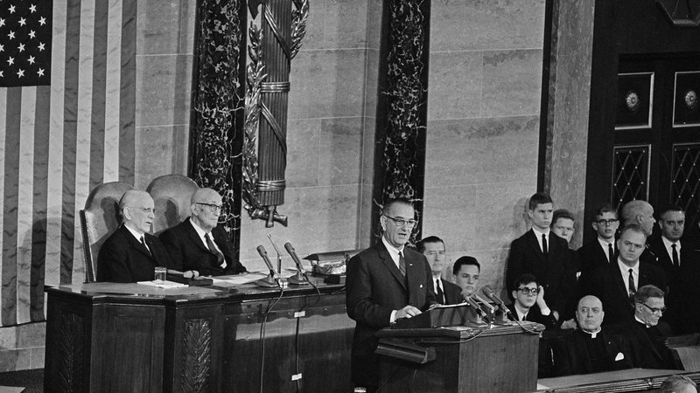
A Brief History of Community Action

Slide 3
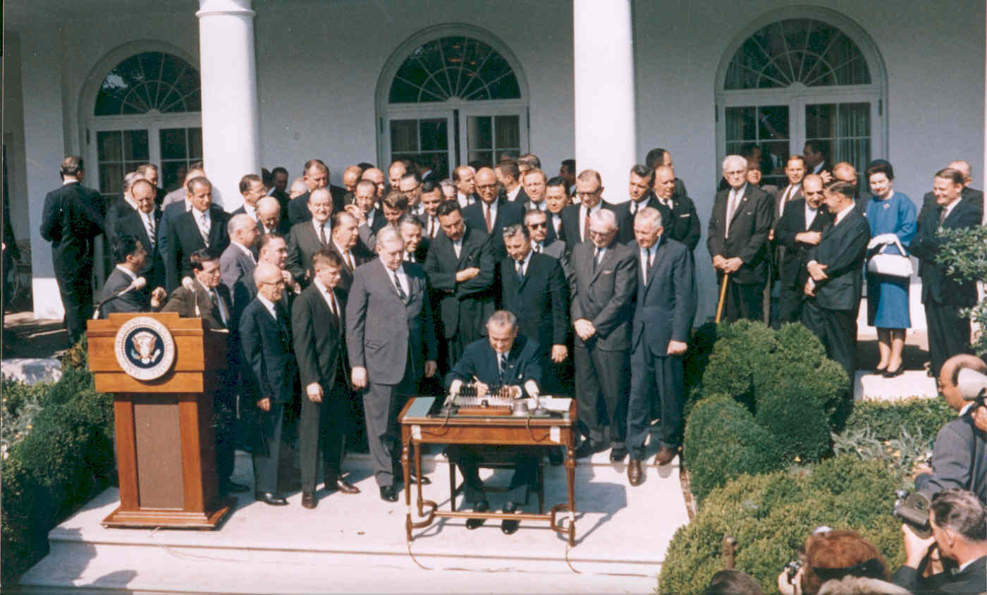
Challenges Met

Slide 4
Lessons Learned

Slide 5
Community Action Today
Photo courtesy of: HAPCAP

Slide 6
Challenges to Meet
Photo courtesy of: Community Concepts

Slide 7
The Community Action Agenda Moving Forward
Photo courtesy of: Community Concepts

Slide 8
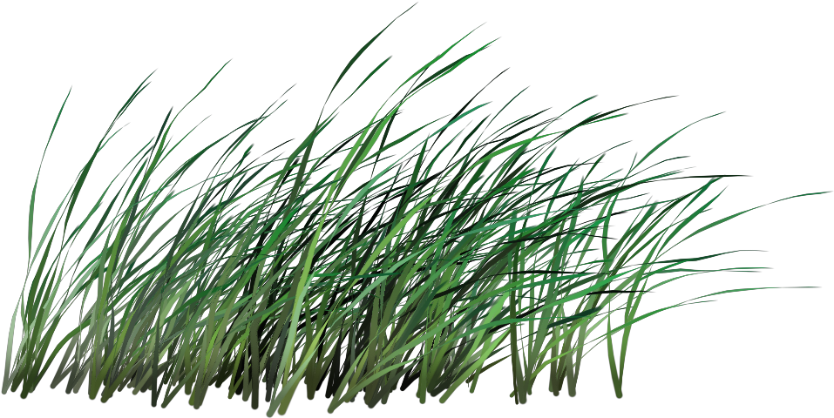
Community Action: Our Moment

Slide 9
Questions?

Slide 10
In House Business...
2020 NCAF Membership is open and completely free! Find out more at NCAF.org.
As always, please consider donating to NCAF. We appreciate any support.
Stay in touch with NCAF! Email is the best way to reach us right now. Reach out to info@ncaf.org with any questions.
Be sure to check out NCAF’s new website! www.ncaf.org.
Follow us on Facebook or Twitter @NCAFNews

Slide 11
Thank you!
Stay well.

