Slide 1
State Association/CSBG State Office
CARES Spending
Conversation with
OCS and the
National Partners
Thursday April 14, 2022

Slide 2
The Promise of Community Action
Community Action changes people’s lives, embodies the spirit of hope, improves communities, and makes America a better place to live. We care about the entire community and we are dedicated to helping people help themselves and each other.

Slide 3
Presenters
Denise Harlow, NCAP
Charisse Johnson, OCS
David Bradley, NCAF
Allison Ma’luf, CAPLAW
Jeannie Chaffin, NACSCP
Lana Shope, NCAP

Slide 4
Purpose of CSBG CARES
To Prevent
Prepare for
Respond to COVID-19
***Includes: addressing the consequences of increasing unemployment and economic disruption as a result of COVID-19.

Slide 5
CSBG CARES Supplemental Funding Spending Analysis

Slide 6
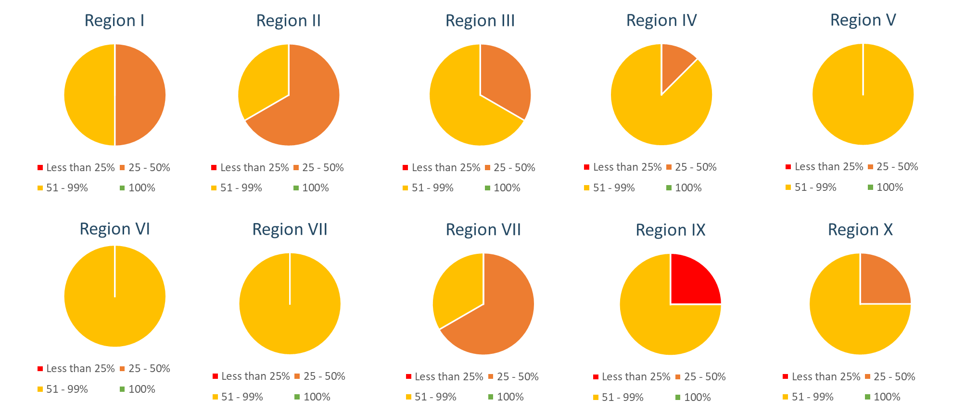
CSBG CARES States Supplemental Funding Spending Analysis by Region

Slide 7
Moving in the Right Direction…
Amount Disbursed January through April, 2022:
$111,793,323.45 (11%)

Slide 8
More Work to be Done…
Amount Disbursed January through April, 2022:
$80,629.50 (1%)

Slide 9
Why Should We Care About CARES?
Family, Agency, Community Needs Still Exist
Disruptions and economic instability caused by the COVID-19 pandemic persist
Eliminating poverty and uplifting communities is paramount to the CSBG mission
CSBG CARES is an Opportunity to Demonstrate our Value
Spending the money reinforces....Community Action is a winning issue
We will be emboldened to respond to the next crisis
Reauthorization
This Photo by Unknown Author is licensed under CC BY-SA

Slide 10
We All Have a Role to Play
Role of the Office of Community
Services (OCS)
National Partners
Role of the State Associations
Role of State Offices
Role of Local CAAs
This Photo by Unknown Author is licensed under CC BY

Slide 11
Top Ten Spending Ideas
#10 Customers
• Food
• Transportation-gas, car repairs
• School supplies

Slide 12
Top Ten Spending Ideas
#9 Children and Youth Activities
• Scholarships for activities
• Summer learning program
• Childcare expenses
• Work with library and provide staff for a summer
reading program
• Supplement a summer feeding program- wrap around services

Slide 13
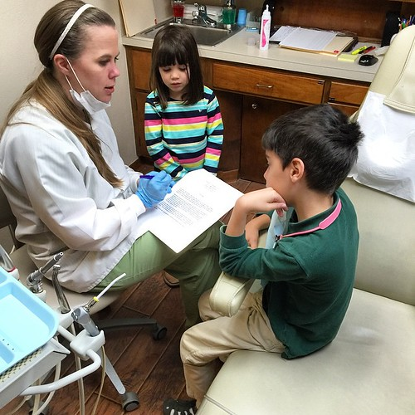
Top Ten Spending Ideas
#8 Health
• Vaccination
• Wellness visits
• Co-pays
• Dental
• Vision
• Mental health-kids & adults
• Burial expenses

Slide 14
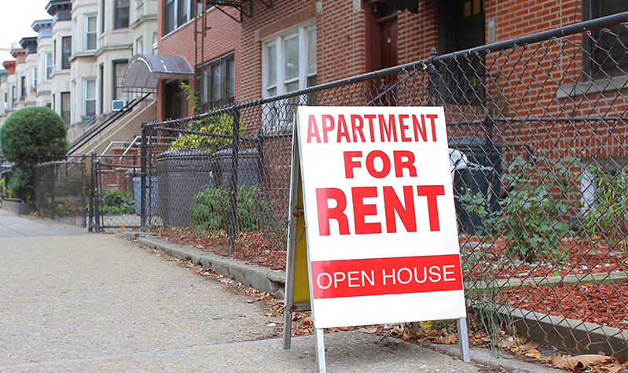
Top Ten Spending Ideas
#7 Housing
• Eviction protection
• Rent assistance
• Water, utility payments

Slide 15
Top Ten Spending Ideas
#6 Technology
• Agency upgrades-improved website, document scan, phone system
• Customer upgrades-online food pantry, online applications
• Community partner needs
• Technology for customers

Slide 16
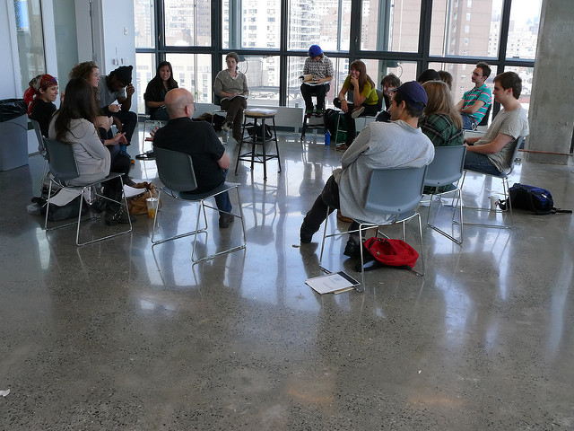
Top Ten Spending Ideas
#5 Customer Engagement*
• Focus groups-assess needs as emerge from pandemic (pay customers for expertise/employee or independent contractor)
• Door to door campaign in the community (pay customers to do the surveying/employee or independent contractor)
• Establish robust customer advisory group (pay for customer expertise)
• Customer Leadership Training Program (e.g., Step up to Leadership
*Operational due diligence

Slide 17
Top Ten Spending Ideas
#4 CAA Capacity
• Training /Leadership (executive coaching, motivational interviewing, coaching, CCAP)
• Support (counseling for staff)
• Trauma informed practices for staff
• Employee benefits/retaining employees
• CAA preparedness/upgrading policies and procedures
• Increase recruitment strategies/marketing

Slide 18
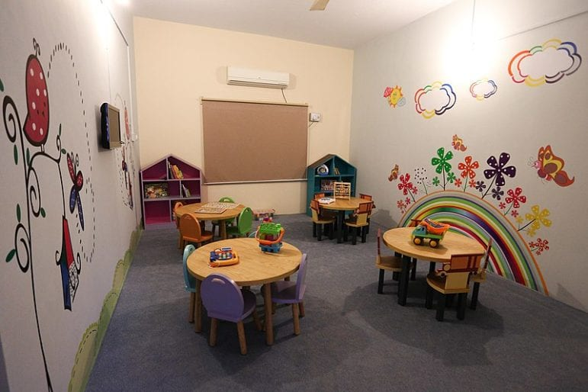
Top Ten Spending Ideas
#3 Small Business Support
• Provide PPE to childcare centers/homes
• Providing coaching to low-income
entrepreneurs and mentorship programs

Slide 19
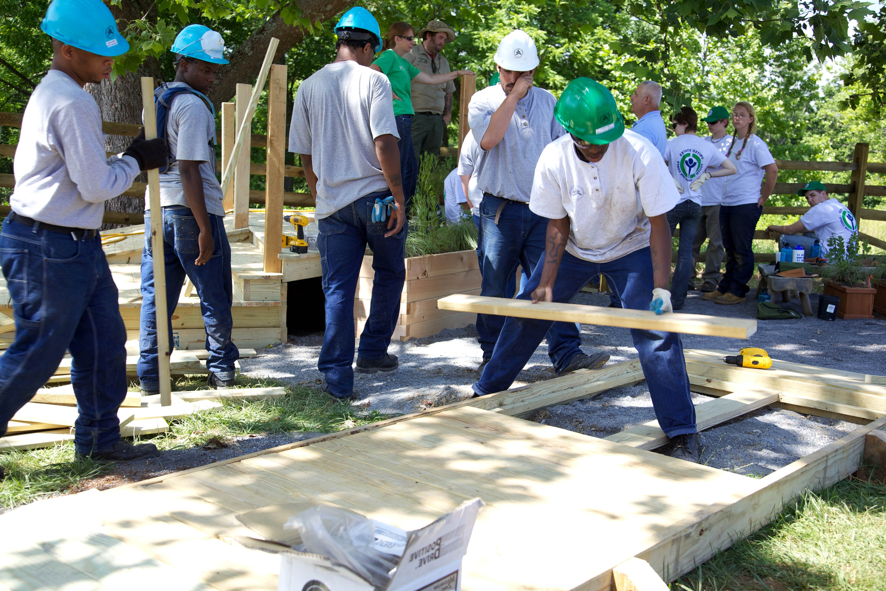
Top Ten Spending Ideas
#2 Job Training
• Pay enrollment fees for training
• Partner with an organization to do a summer apprenticeship program at CAA
• WAP or Early Care and Education Career Path Project - partner with community college, pay stipends to attendees, pay OJT, hire participants*
*Operational due diligence

Slide 20
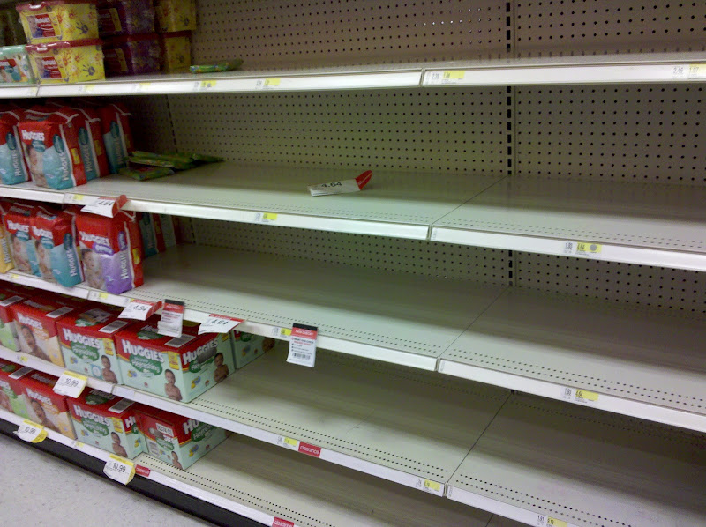
Top Ten Spending Ideas
#1 Pop Up events
• Food
• Diapers
• School preparation
• Gas cards
• Vehicle repair

Slide 21
What Do You Need?
CAPLAW Guidance?
T & TA with NCAP & NASCSP?
Additional Information from OCS?

Slide 22
CARES CSBG Spending Office Hours
April 18, 2022
3:00 ET/2:00 CT/1:00 MT/12:00 PT
Register:
https://communityactionpartnership.zoom.us/meeting/register/tZUrdu-hrDorHNNwEgrQeJzamdmfDMUU4Hh5
April 25, 2022
3:00 ET/2:00 CT/1:00 MT/12:00 PT
Register:
https://communityactionpartnership.zoom.us/meeting/register/tZIvceihqDIiGNLKpZLXKOpM-TG7eJ1sNthI

Slide 23
For More Info
For more information or questions contact the HCCT CARES Project Team:
Denise Harlow, CCAP, Chief Executive Officer
dharlow@communityactionpartnership.com
Aaron E. Wicks, PhD, CCAP, NCRT, VP Organizational Capacity Building
awicks@communityactionpartnership.com
Maribeth Schneber-Rhemrev, CCAP, PMP, NCRT, Director, Organizational Capacity Building
mschneberrhemrev@communityactionpartnership.com
Lana Shope, CCAP, Project Director, NCAP CARES Project
lshope@communityactionpartnership.com
Partnership website: www.communityactionpartnership.com
This presentation was created by the National Association of Community Action Agencies – Community Action Partnership, in the performance of the U.S. Department of Health and Human Services, Administration for Children and Families, Office of Community Services Grant Number, 90ET0469-01-01 . Any opinion, findings, and conclusions, or recommendations expressed in this material are those of the author(s) and do not necessarily reflect the views of the U.S. Department of Health and Human Services, Administration for Children and Families.

Slide 25
